Slide 1
ON/OFF SWITCH
36V Sub-System
MOTOR
ESC
ANTI-SPARK SWITCH
BATTERIE
DC/DC
BMS
BATTERY
MOTOR
ESC
DC/DC
CHARGER
5V Sub-System
NEBENVERBRAUCHER

Slide 2
BMS
P-/C-
B-
BATTERY CELL 3,7V
BATTERY CELL 3,7V
BATTERY CELL 3,7V
BATTERY CELL 3,7V
BATTERY CELL 3,7V
BATTERY CELL 3,7V
BATTERY CELL 3,7V
BATTERY CELL 3,7V
BATTERY CELL 3,7V
BATTERY CELL 3,7V
BATTERY CELL 3,7V
BATTERY CELL 3,7V
BATTERY CELL 3,7V
BATTERY CELL 3,7V
BATTERY CELL 3,7V
BATTERY CELL 3,7V
BATTERY CELL 3,7V
BATTERY CELL 3,7V
BATTERY CELL 3,7V
BATTERY CELL 3,7V
discharging / charging negative
discharging / charging positive
P- / C-
B+

Slide 3
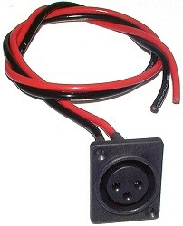
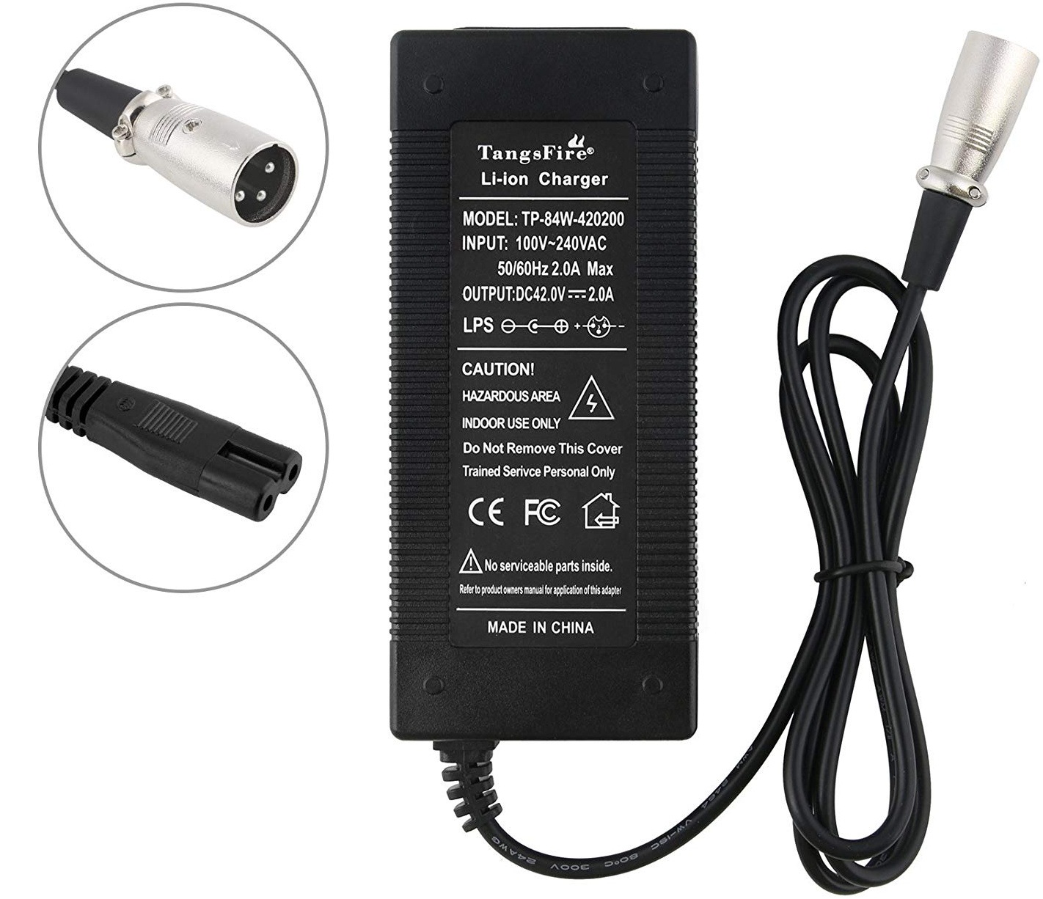
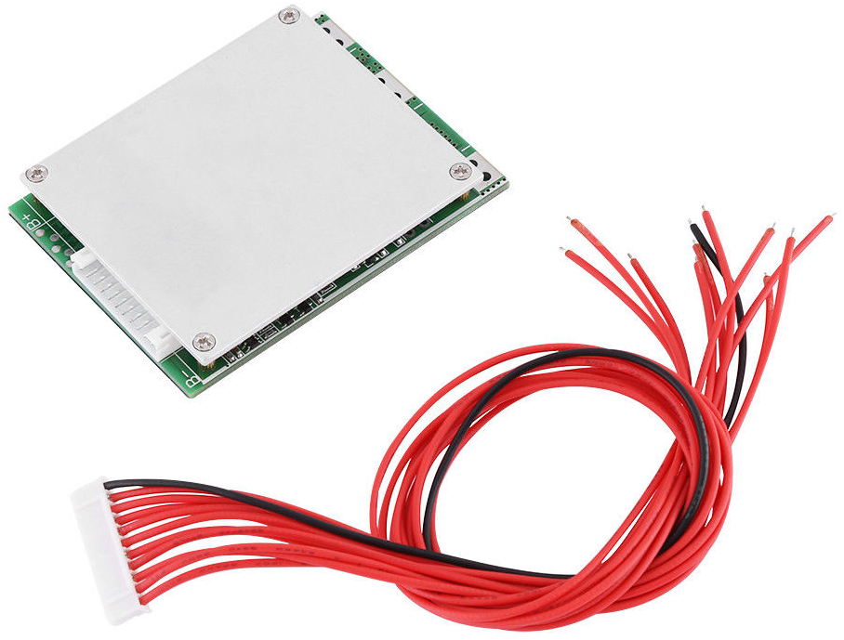
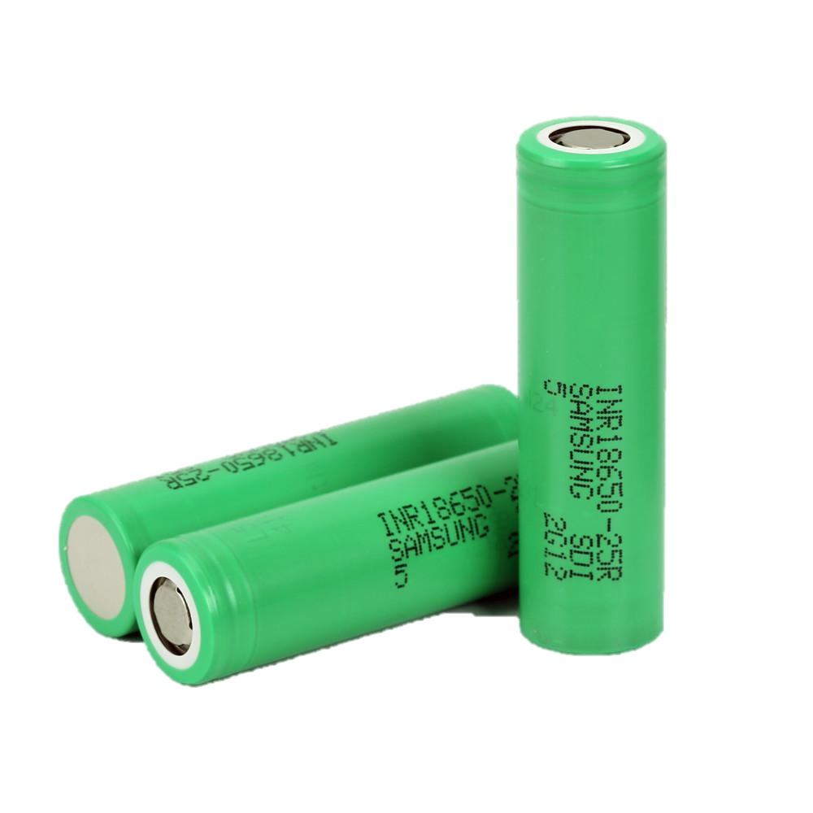
BATTERIE
BMS
BATTERY
CHARGER
INPUT: 100V-240V AC OUTPUT: 42 V DC – 2.0 A
Overcharge Detection Voltage | 4.28 ± 0.05 V
Overcharge Protection Delay | 100 mS
Overcharge Cancel Voltage | 4.08 ± 0.05 V
Balance Detection Voltage | 4.2 ± 0.025 V
Balance Cancel Voltage | 4.2 ± 0.05 V
Balance Current | 56 ± 5 mA
Over-discharge Detection Voltage | 2.55 ± 0.08 V
Over-discharge Detection Delay | 50 mS
Over-discharge Cancel Voltage | 3.0 ± 0.1 V
Overcurrent Detection Voltage | 150 mV
Overcurrent Detection Delay | 15 mS
Overcurrent Protection Current | 120 ± 5 A
Protection Cancel Condition | Disconnect Load
Short Circuit Protection Condition | Outside Load Short Circuit
Short Circuit Detection Delay | 200 uS
Protection Cancel Condition | Disconnect Load
 | -30℃ ~ +80℃
Continuous Discharge Current | 35 A
Momentary Discharge Current | 100 A
36 V – 10 S – 35 A
INR18650-25R Rapid charge CC-CV, 4A, 4.20 ± 0.05 V, 100mA cut-off Discharge cut-off voltage/ End of discharge 2.5V

